Slide 1
Data Visualization
with Plotly for Python
Pamela Pan, Data Services Fellow
shanghai.library.data@nyu.edu
Fall 2021, NYU Shanghai Library

Slide 2
Timeline
Data Visualization Series
Data Visualization with Plotly for JavaScript
October 21, 2021
10-11:30 am (90 min)
AB Room 415
Intro to Data Visualization on Web Interfaces
October 15, 2021
9:30-10:30 am (60 min)
AB Room 415
Data Visualization with Plotly for Python
Data Dashboarding with Plotly for
Python
October 21, 2021
10-11:30 am (90 min)
AB Room 415
October 28, 2021
10 am -12 pm (120 min)
AB Room 415

Slide 3
Workflow
Part I: Learn the Basics
● Plotly for Python & Google Colab
● GapMinder data
Part II: Let’s Code!
● Open Jupyter Notebook and follow through!

Slide 4


● Plotly & Google Colab
Plotly is a graphing library that binds to many languages, including JavaScript (read more from last workshop).
Built on D3.js, high interactivity by default
High-level library → Allows concision in code
Interactive, scientific charts
Google Colab is an executable document that lets you write, run, and share code within Google Drive.
Zero configuration required locally
Free access to GPUs
Easy sharing, good for teamwork

Slide 5
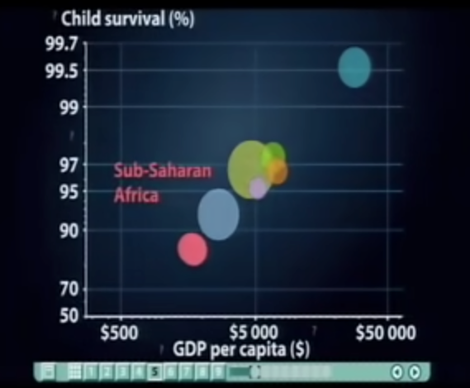
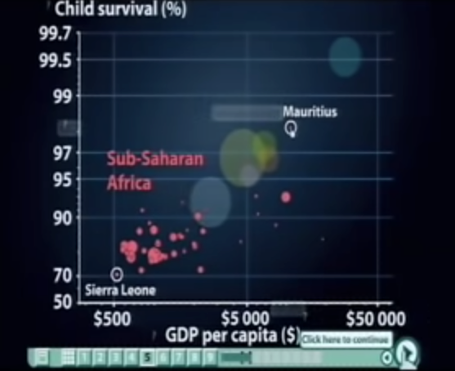
● Why explore Gapminder Data?
A rich, searchable collection of public datasets about the world’s trends.
Gathered from institutions like the UN
Provides online statistical tool for explorations.
First presented by Hans Rosling, its co-founder, in 2007
The best stats you've ever seen | Hans Rosling
Notes:
We tend to discuss universal solutions for a region/ a country, but neglect the fact that the aggregated data is made by the fine grains of individual data.
If these fine grains of data are buried in some databases, not accessible for explorations, not understood for good, we won’t have a good idea of what is happening

Slide 6
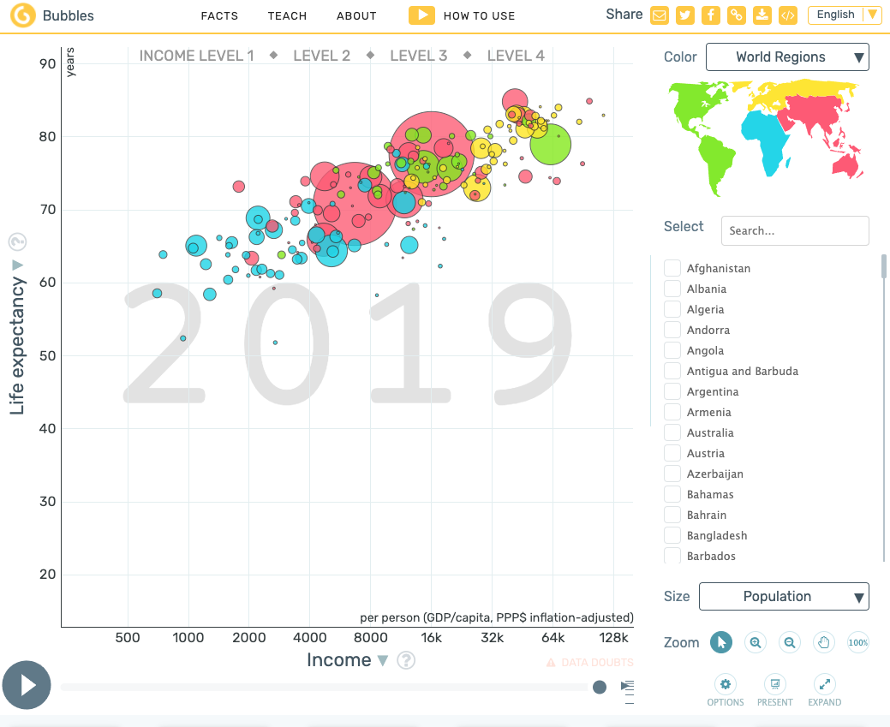
● Why explore Gapminder Data?
Motivations
Link data to design
Provide clean datasets that are searchable and useable
Be hypothesis-generating
What we’ll do today
Use dataset between 1952-2007 to make different interactive graphs
Generate hypothesis and insights about data

Slide 7
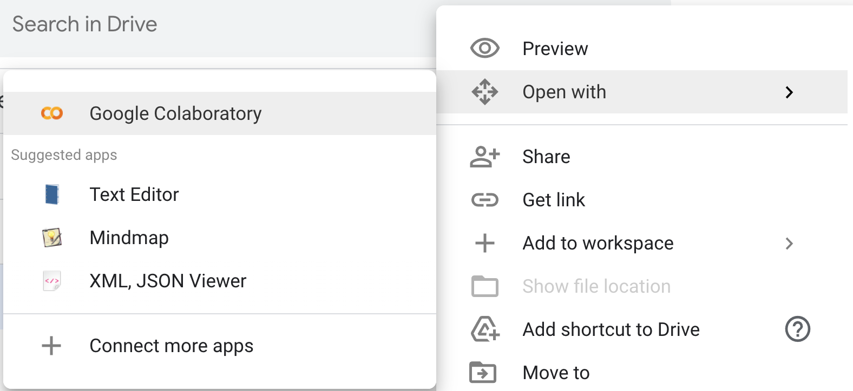
● Let’s Code! Open Google Colab
Open tinyurl.com/datavizworkshops
Go to “Workshop 10-22”
Open “2_Let’s Code” with Google Colab
If not yet installed, click “Connect more apps” and search for Google Colab

Slide 8
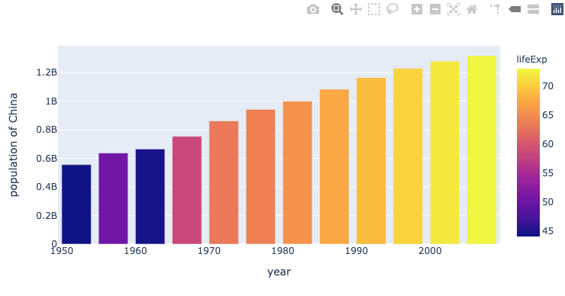
What you see
(Output)
Code behind-the-scenes
(Powered by Plotly Python library)
Entry/ Imported Modules
Structures of Figures
“Plotly figures”
plotly.express*
Plotly Graph Object*
*Recommended entry point, higher-level module, so less code will be written. Will also return fully-populated graph objects.
*Serialized as JSON before being passed onto Plotly.js, which renders the figure under the hood, but we won’t have to interact with it today.
plotly.graph_objects*
*Includes more graph types (e.g. 3-D), but generally needs more lines of code to be written.
Python dictionary*
plotly.figure_factory*
*A lot less convenient, especially in catching errors.
*Includes unique, sophisticated chart types (e.g. subplots, tables) yet to be included in plotly.js.
Notes:
Plotly Python library
(What you’d use to code —create, manipulate, and render— figures)

Slide 9

Thank you!
Contact: shanghai.library.data@nyu.edu
Other workshop resources:
👉 http://shanghai.hosting.nyu.edu/data/
Feedback form
tinyurl.com/libworkshopfeedback

